Slide 1
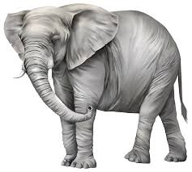
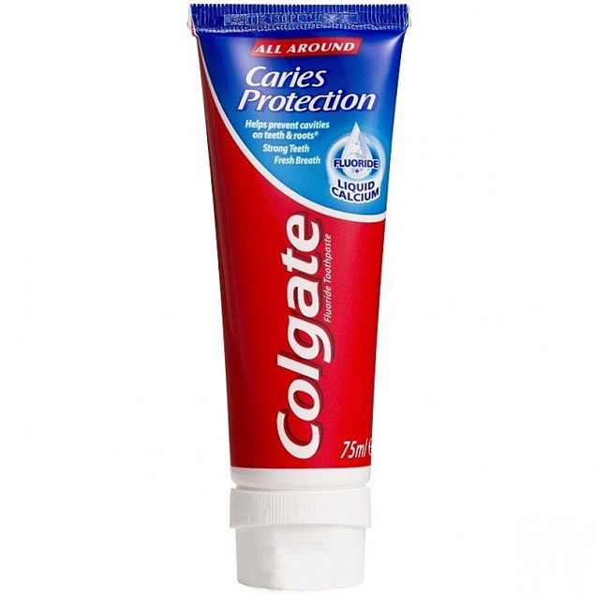
Elephant toothpaste

Slide 2
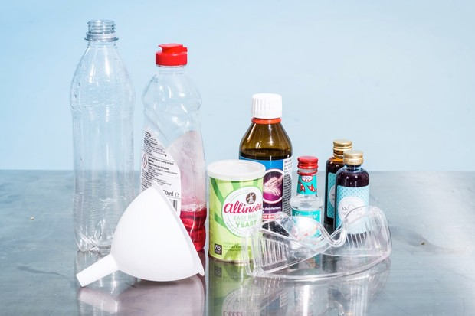
`What you will need:
A clean plastic bottle
1/2 cup 20-volume hydrogen peroxide liquid (20-volume is a 6% solution, ask an adult to get this from a beauty supply store or hair salon)
1 Tablespoon of dry yeast
3 Tablespoons of warm water
Liquid dish washing soap
Food coluoring
Small cup
Safety goggles
NOTE: The foam will overflow from the bottle, so be sure to do this experiment on a washable surface, or place the bottle on a tray.

Slide 3
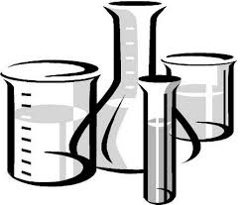
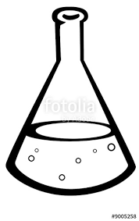
Method:
Hydrogen peroxide can irritate skin and eyes, so put on those safety goggles and ask an adult to carefully pour the hydrogen peroxide into the bottle.
Add 8 drops of the food colouring into the bottle.
Add about 1 tablespoon of liquid dish soap into the bottle and swish the bottle around a bit to mix it.
In a separate small cup, combine the warm water and the yeast together and mix for about 30 seconds.
Now the adventure starts! Pour the yeast water mixture into the bottle (a funnel helps here) and watch the foaminess begin!

Slide 4
Why is there a reaction:
Foam is awesome! The foam we made is special because each tiny foam bubble is filled with oxygen. The yeast acted as a catalyst (a helper) to remove the oxygen from the hydrogen peroxide. Since it did this very fast, it created lots and lots of bubbles. Did you notice the bottle got warm. Our experiment created a reaction called an Exothermic Reaction – that means it not only created foam, it created heat! The foam produced is just water, soap, and oxygen so you can clean it up with a sponge and pour any extra liquid left in the bottle down the drain☺☺

Slide 5
Safety Tip:☺
Make sure to wear goggles just in case it gets in your eyes!!!☺
Also don't forget to stand back so you wont get covered in ELEPHANT TOOTHPASTE ☹

Slide 6
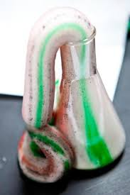
Results:

