Slide 1
MAGNETIC CAR

Slide 2
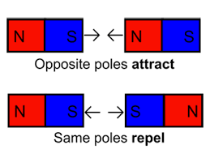
What are Magnets?
A magnet is a rock or a piece of metal that can pull certain types of metal toward itself. The force of magnets is called magnetism.
Magnetism works over a distance. This means that a magnet does not have to be touching an object to pull it.
A magnet has 2 sides a North Pole and a South Pole

Slide 3
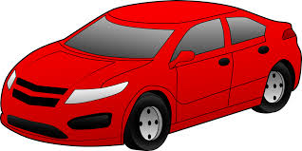
BLUE TACK CARD BOARD STRAW SELLOTAPE TWO MAGNNETS EMPTY MATCH BOX ONE EURO
What you will need:

Slide 4
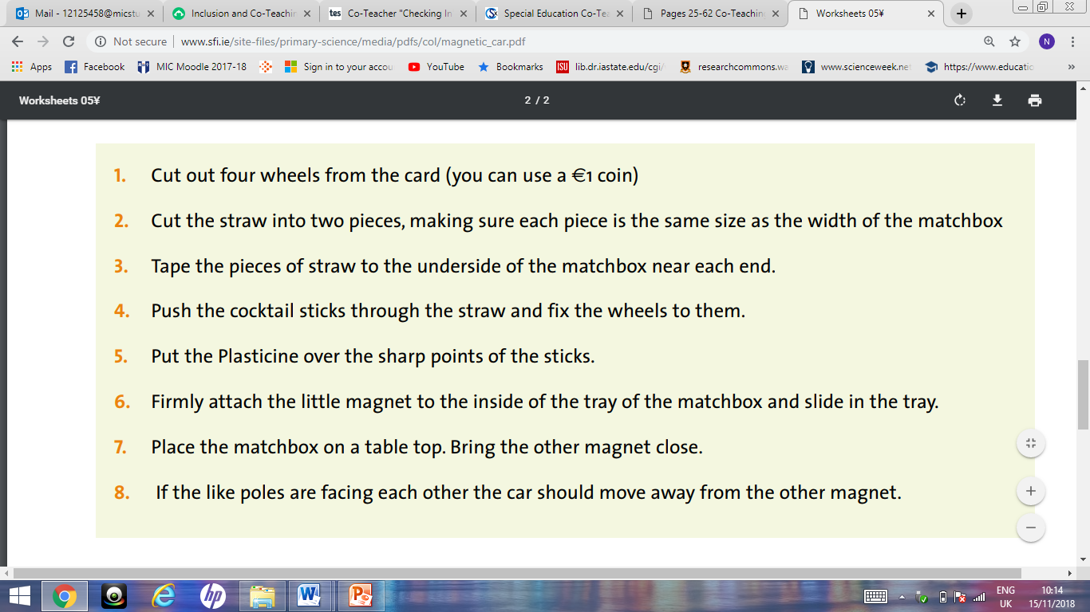
Method:

Slide 5
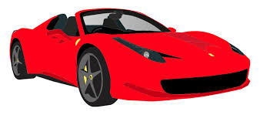
Results
Thank you for watching!!

