Slide 1
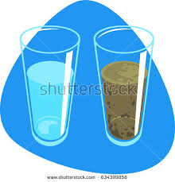
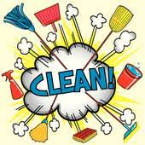
Cleaning dirty water

Slide 2
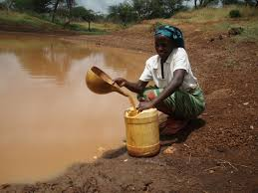
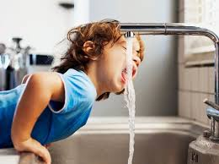
Why we need clean water
In Ireland we have access to clean water however in third world countries some people do not. Many people have to walk miles to get water yet the water is still dirty.
Today we are going to figure out how to filter dirty water.

Slide 3
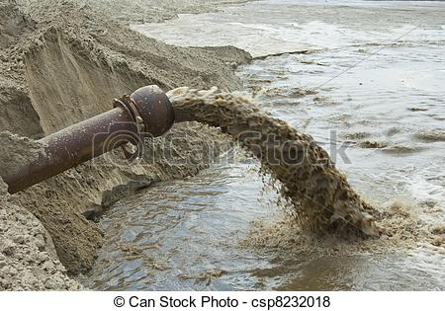
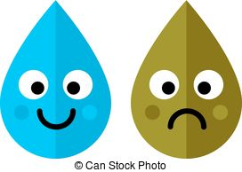
What you will need
A jar of dirty water
Funnels
Tights
Tissue paper
Coffee paper

Slide 4
Methods
Step 1 Make or get some dirty water.
Step 2 :Cut the filter samples so that they are all the same size. (so that it is a fair test)
Step3: Line the funnels with the filter samples.
Step4 pour the same amount of dirty water into the funnels.
Step5 observe. Whichever water comes out the cleanest, this has past through the best filter.

Slide 5
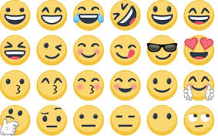
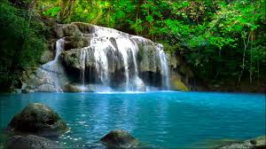
Results

Slide 6
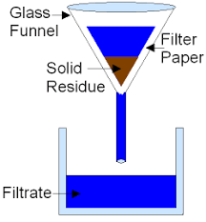
How do filters work?
A good filter will let the water pass through it but will not let any dirt or unwanted material pass through.

