Slide 1
ROCKET LAUNCH

Slide 2
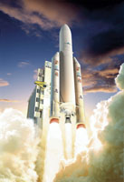
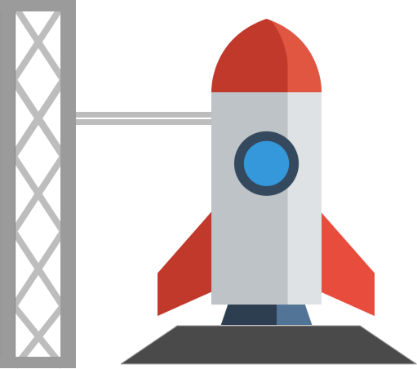
What is a rocket
Rockets are used to launch satellites and Space Shuttles into space. Their powerful engines allow spacecraft to be blasted into space at incredible speeds, putting them into the orbit.

Slide 3
What you will need
Large balloons
balloon pump
string or cotton fishing line 3.4 m
drinking straw
Clothes peg
sellotape
2 chairs

Slide 4
What to do
1 Blow up a long-shaped balloon and let it go
2 Notice what happens
Pull string through a drinking straw
Tie the string to two chairs and pull it tight
Blow up a long-shaped balloon and keep the air in it using a clothes peg
Using sellotape attach the balloon to the side of the straw
Pull the whole thing back to the beginning of the string and take off the clothes peg and … launch your rocket

Slide 5
Results

