Slide 1
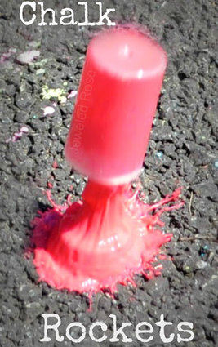
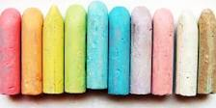
How to make chalk rockets

Slide 2
How to make Chalk rockets
You will need:
Alka-seltzer
Corn flour
Water
Food colouring
Film canisters/container with a lid

Slide 3
What to do:
Begin by mixing an equal amount of water and corn starch in a bowl or container.
This will give your base chalk. Once well mixed pour the chalk mixture into the small container, filling them roughly 1/3 of the way. You can alter the amount of chalk you add as you play as you produce different art effects.

Slide 4
Add a few drops of food colouring to the container.
Take a tablet of alka-seltzer and toss it into the container, quickly secure the lid and then place the rocket on the ground.
In a matter of seconds the rocket will fly high into the air, leaving a blast of paint all over the ground below
SAFETY TIP!!!!
STAND BACK FROM THE ROCKET !!!!!!

